Slide 1
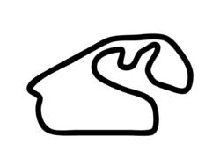
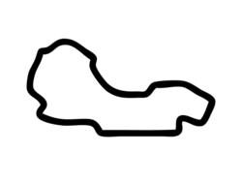
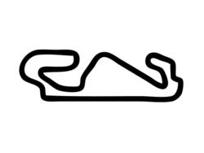
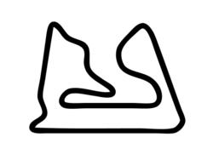
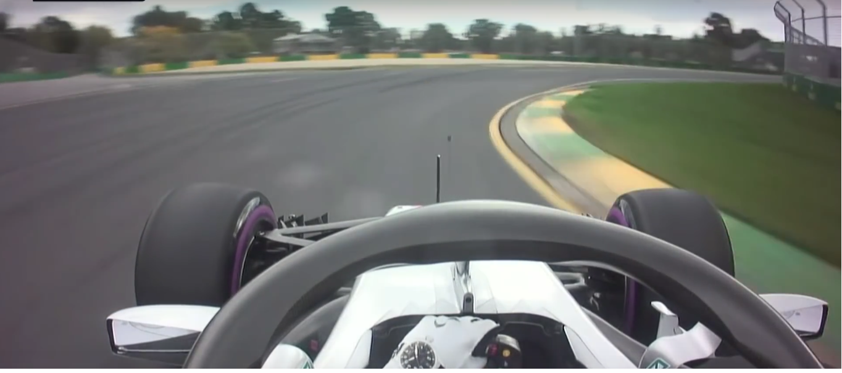
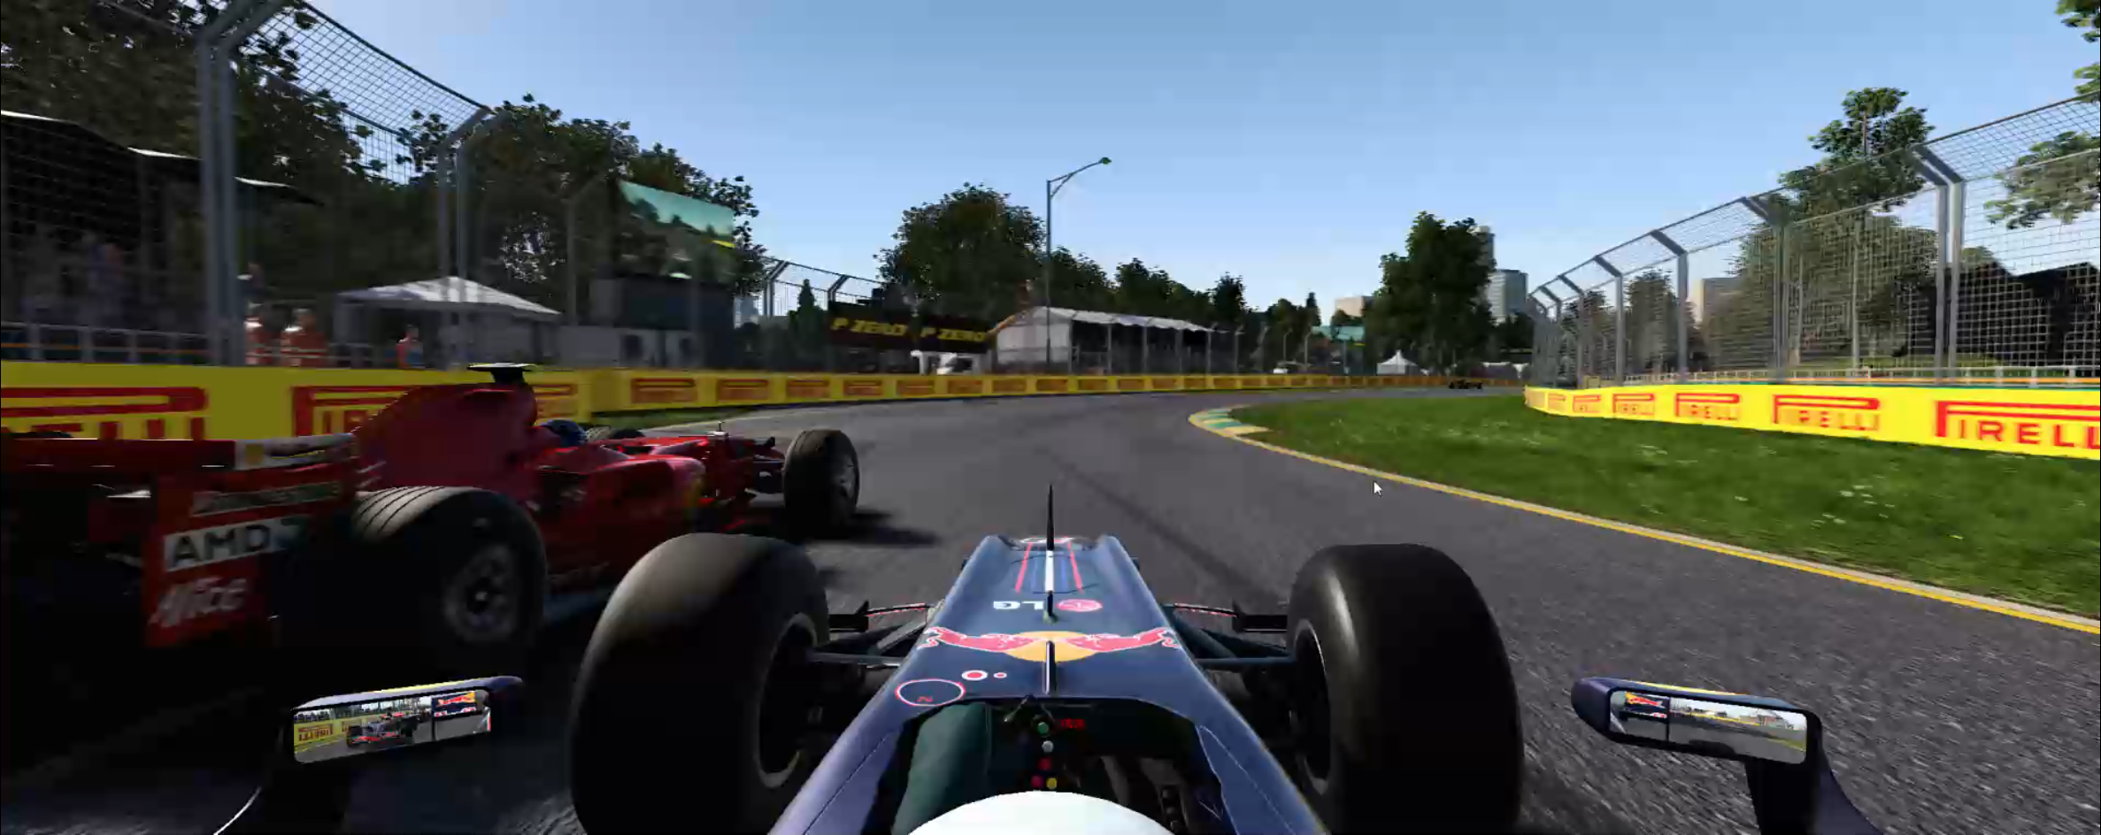




Control Inputs:
Steering
Velocity
Acceleration
Large variety of tracks and car configurations
Utilize Photo-realism of F1 2017™
≈
Virtual Joystick
Real Formula One
Game responds to input
F1 2017™
UDP
C++ API
Closing The Loop
Predicted Steering
AdmiralNet
Annotated Training Images
Assign labels
Game Screenshots
Steering
Velocity
Acceleration

Slide 2





Steering angles from UDP Packets
Steering Angle
Image
Time

Slide 3
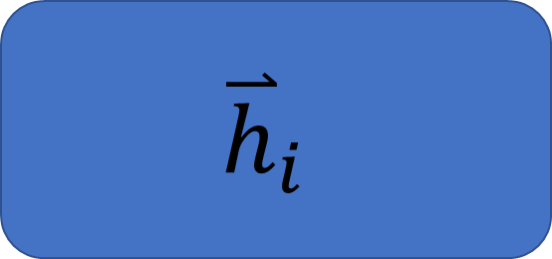

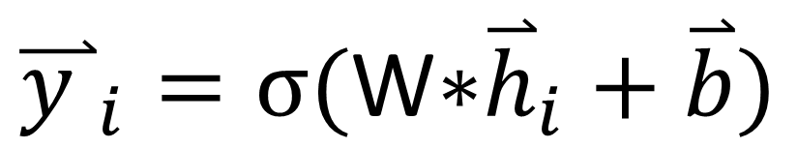


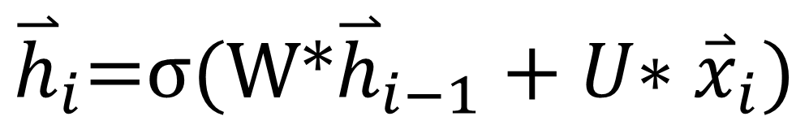

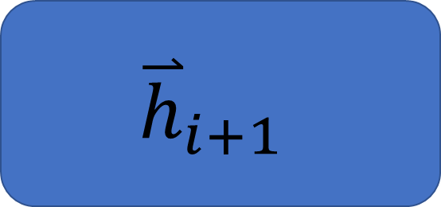
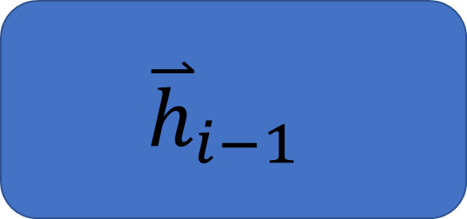



$${\overset{⃑}{y }}_{i}=σ\text{(}\text{W}\text{∗}{\overset{⃑}{h}}_{i}+\overset{⃑}{b})$$
${\overset{⃑}{y }}_{i−1}$
${\overset{⃑}{y }}_{i}$
${\overset{⃑}{y }}_{i+1}$
$${\overset{⃑}{h}}_{i}\text{=}σ\text{(}\text{W}\text{∗}{\overset{⃑}{h}}_{i−1}+U\text{∗} {\overset{⃑}{x}}_{i})$$
RNN Cell
…
Unfold
$${\overset{⃑}{h}}_{i−1}$$
$${\overset{⃑}{h}}_{i}$$
$${\overset{⃑}{h}}_{i+1}$$
$${\overset{⃑}{x}}_{i}$$
${\overset{⃑}{x}}_{i−1}$
${\overset{⃑}{x}}_{i}$
${\overset{⃑}{x}}_{i+1}$

Slide 4
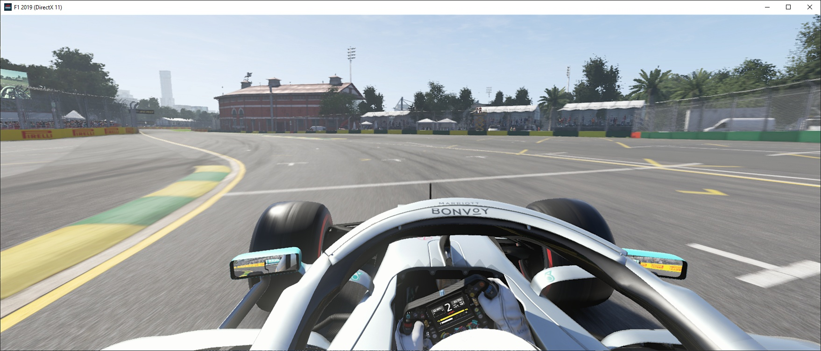
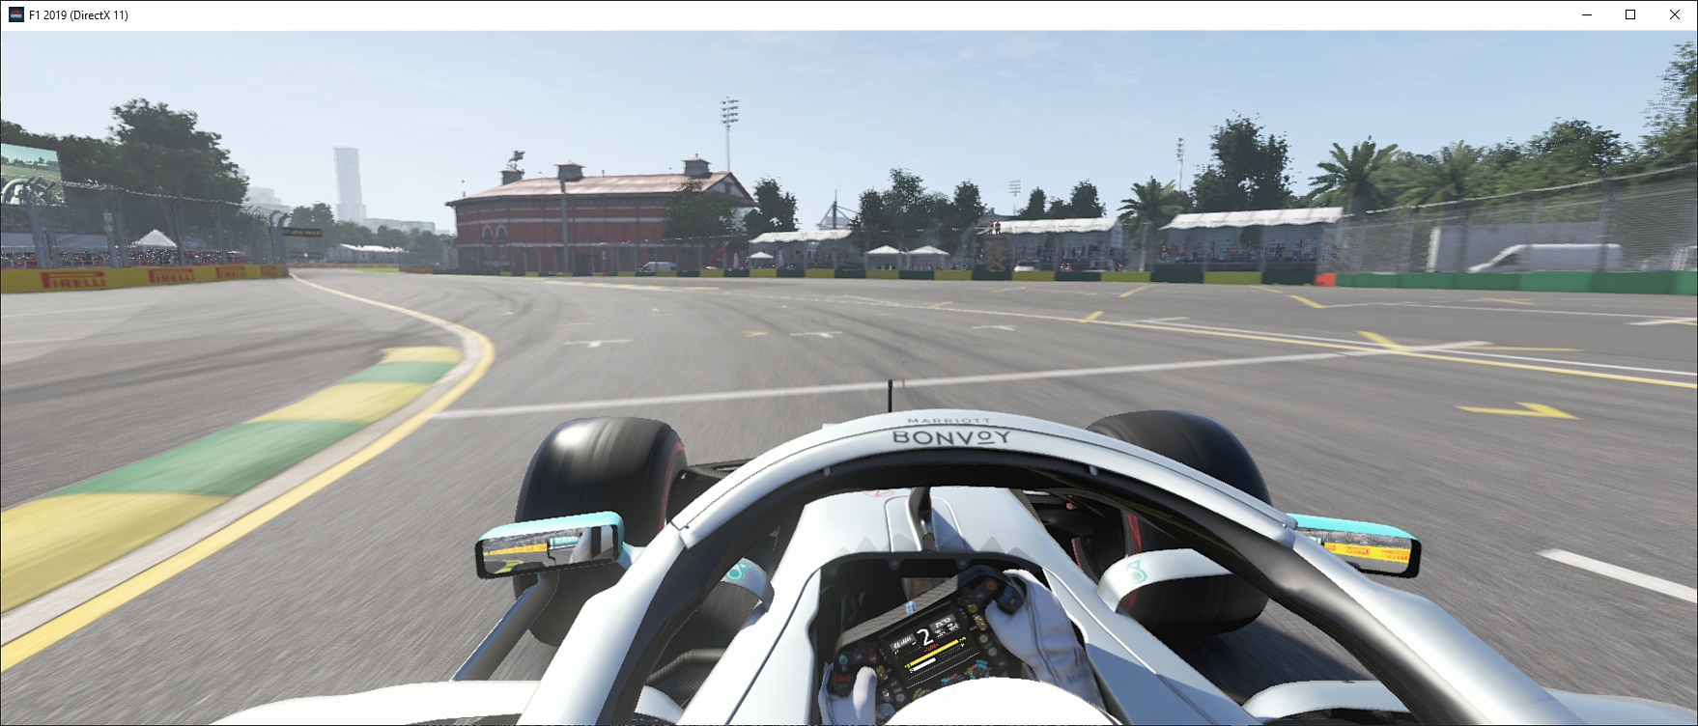
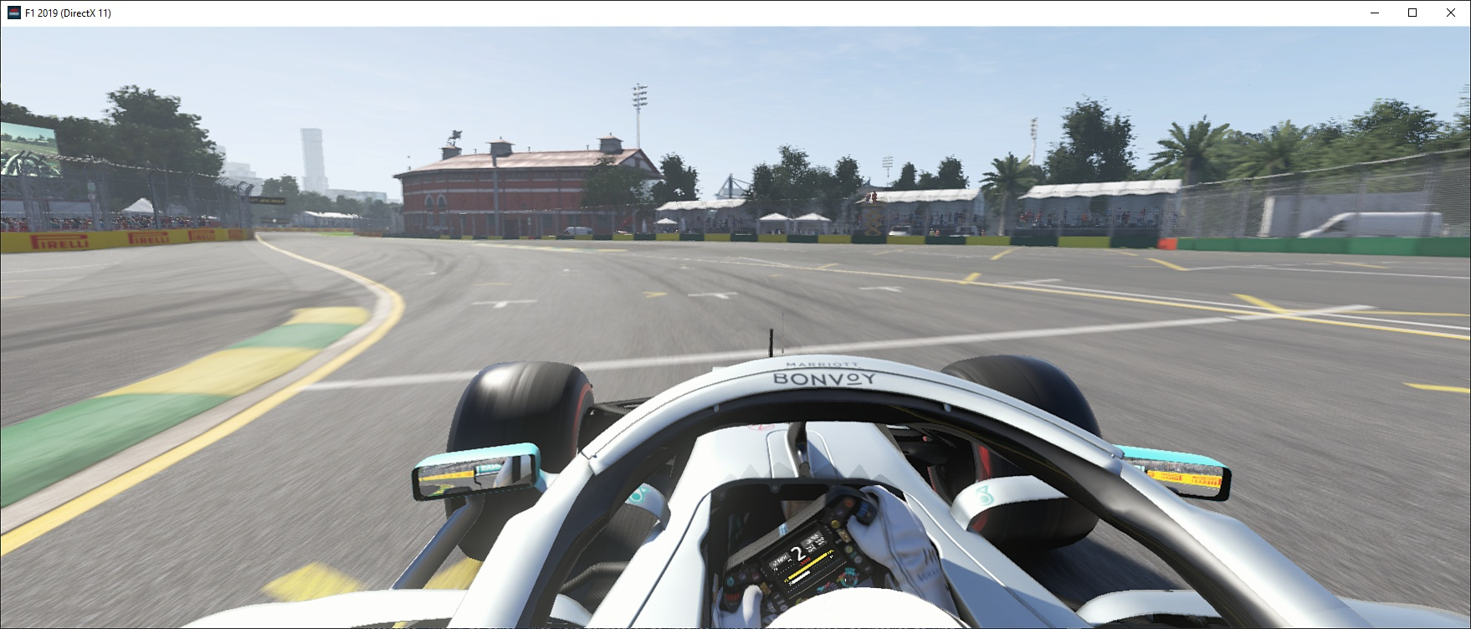
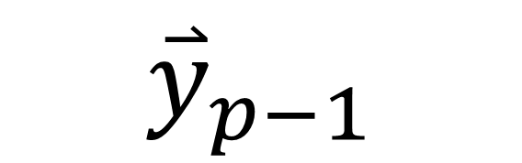





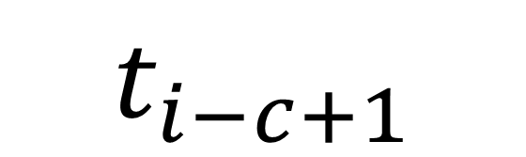
Predicted Waypoints
Build Temporal Context
$${\overset{⃑}{y}}_{0}$$
$${\overset{⃑}{y}}_{1}$$
$${\overset{⃑}{y}}_{p−1}$$
LSTM
LSTM
LSTM
LSTM
LSTM
LSTM
$${\overset{⃑}{h}}_{0}$$
…
…
2D Deep Convolutional Neural Network
2D Deep Convolutional Neural Network
2D Deep Convolutional Neural Network
3D Convolutional
Neural Network
Concatenate along time axis
…
$$t_{i−c}$$
$$t_{i−c+1}$$
$$t_{i}$$
Image Sequence

Slide 5

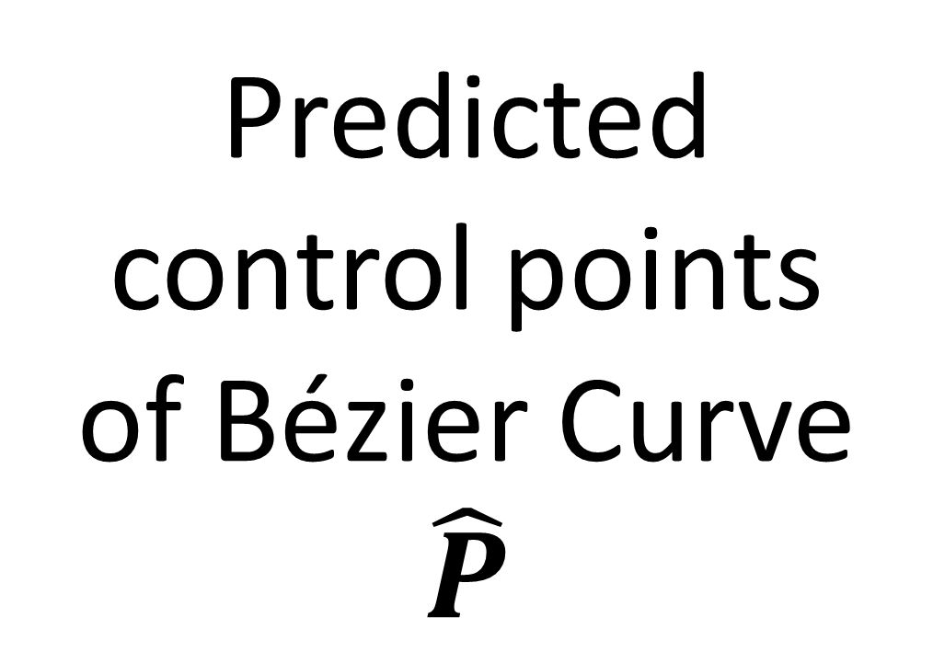


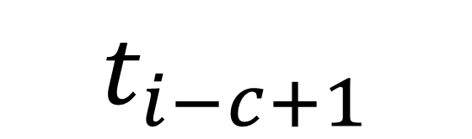
2D Deep Convolutional Neural Network
Fully
Connected
Layers
Predicted control points of Bézier Curve
$$\hat{P}$$
Stack along time axis
Build Temporal Context
$${\overset{⃑}{y}}_{0}$$
$${\overset{⃑}{y}}_{1}$$
$${\overset{⃑}{y}}_{p−1}$$
LSTM
LSTM
LSTM
LSTM
LSTM
LSTM
$${\overset{⃑}{h}}_{0}$$
…
…
2D Deep Convolutional Neural Network
2D Deep Convolutional Neural Network
2D Deep Convolutional Neural Network
3D Convolutional Neural Network
Concatenate along time axis
…
$$t_{i−c}$$
$$t_{i−c+1}$$
$$t_{i}$$
Image Sequence

Slide 6
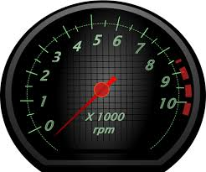
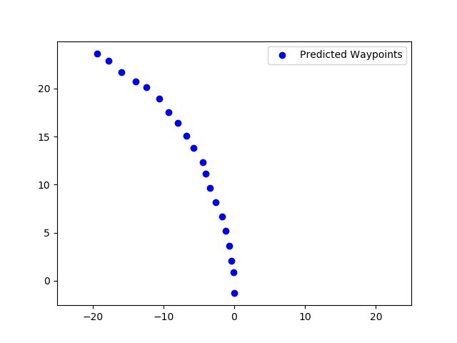
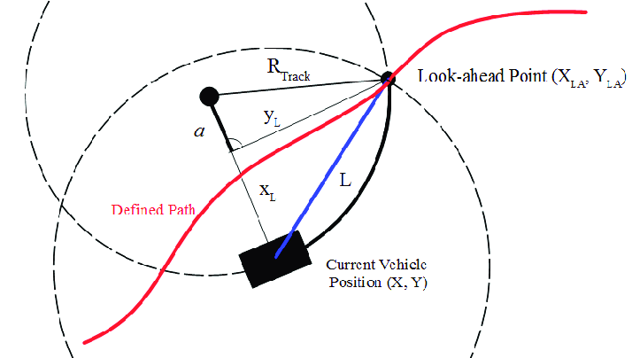
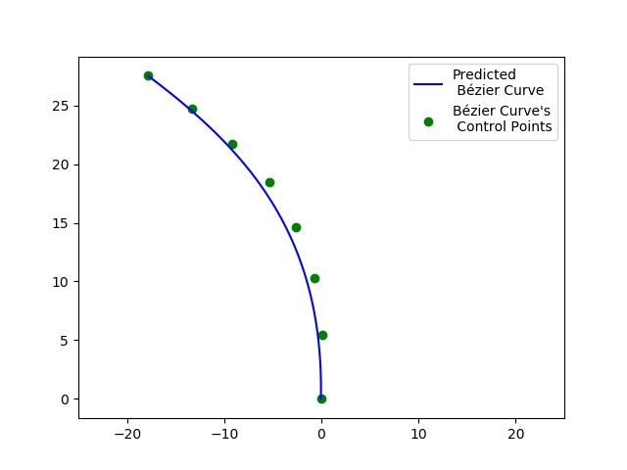
Neural Network
Steering
Pixels to Control
Acceleration
Neural Network
Steering
Pixels to Waypoints
Acceleration
Pure Pursuit Control
Trajectory
Waypoints
Pixels to Curves
Neural Network
Steering
Acceleration
Pure Pursuit Control
Bézier
Curves

